Slide 1
Open problems in distributed storage and resource management
Next-Generation Apache Hadoop
Karthik Kambatla | kasha@cloudera.com
Andrew Wang | andrew.wang@cloudera.com
Notes:
Hi everyone. We’re very glad to be speaking in front of an academic audience today. Actually, before Karthik and I joined Cloudera, we were grad students working in distributed systems. One of the biggest challenges we faced in academia was that of problem definition. Systems design is all about choosing between conflicting trade-offs. Once you’ve crisply formulated the problem, often times the correct design becomes obvious as a result.

Slide 2
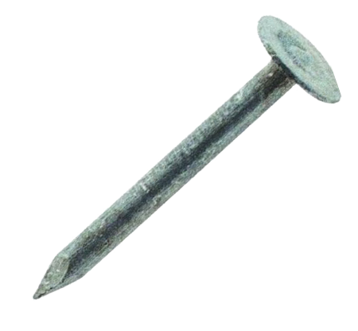
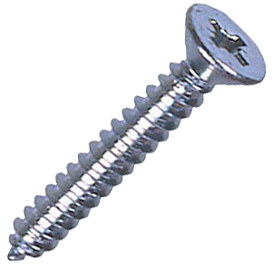
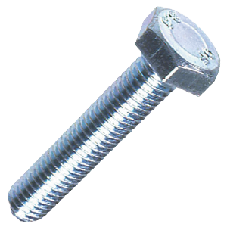
?
?
?

Slide 3


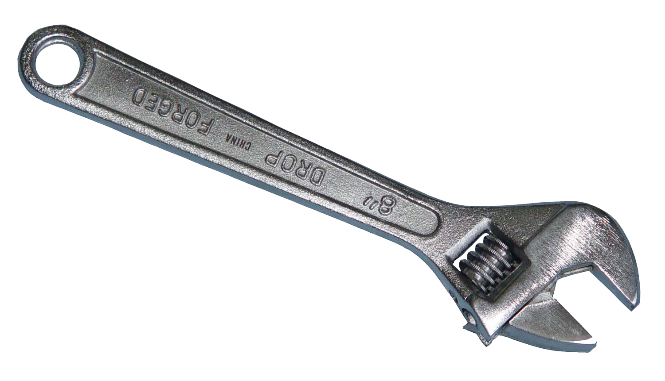

Slide 4
Cloudera perspective
Hadoop software stack is relatively mature
Seen broad uptake in many industries
  Wider variety of workloads
  Larger and larger amounts of data
New datacenter hardware trends on the horizon
Good time to revisit original design assumptions
Collaborate with academics on these problems
Notes:
However, a lot of the cutting-edge systems work is happening in industry. So, we’re here today to provide the Cloudera perspective on open problems in distributed systems.
Our stance is that the time is ripe for innovation. Over the last ten years of Hadoop’s existence, we’ve seen broad uptake in many industries, meaning more and more sophisticated analytic workloads over larger and larger amounts of data. Combined with coming hardware trends that radically change the datacenter architecture, it’s a good time to revisit some of the design assumptions in Apache Hadoop.

Slide 5
Scalability

Slide 6
Worker
Worker
Master
Simple
Do work
Scale-out
Worker
Global view of cluster
Coordinates workers
Worker

Slide 7
DN
Bottleneck
DN
NN
Store blocks
Serve data reads/writes
DN
File metadata
File->block mapping
DN

Slide 8
Vertically scaling HDFS
Project | Improvement | Cost (months)
Multiple volumes per NN | Operational | 6
Split namespace and block management locking | 2x RPC | 12
Fine-grained locking of namespace | 2x RPC | 6
Pageable namespace | 2x object count | 6
Persistent block space | Operational | 6
Block management as a service | 2x object count | 12+
Volume migration | Operational | 12

Slide 9
Scary changes
Project | Improvement | Cost (months)
Multiple volumes per NN | Operational | 6
Split namespace and block management locking | 2x RPC | 12
Fine-grained locking of namespace | 2x RPC | 6
Pageable namespace | 2x object count | 6
Persistent block space | Operational | 6
Block management as a service | 2x object count | 12+
Volume migration | Operational | 12
Notes:
These are scary changes. Each of these involves substantial modification of very complex parts of the system. These types of changes are hard to scope, and also have a high likelihood of introducing bugs.

Slide 10
Incremental
Project | Improvement | Cost (months)
Multiple volumes per NN | Operational | 6
Split namespace and block management locking | 2x RPC | 12
Fine-grained locking of namespace | 2x RPC | 6
Pageable namespace | 2x object count | 6
Persistent block space | Operational | 6
Block management as a service | 2x object count | 12+
Volume migration | Operational | 12
Notes:
The second issue is that the potential upside is only so-so. When pursuing vertical scalability, we’re still ultimately limited by the performance of a single node. Furthermore, changes like fine-grained locking and paging can lead to more performance variability, meaning a system that is less predictable under load.

Slide 11
Years of work
Project | Improvement | Cost (months)
Multiple volumes per NN | Operational | 6
Split namespace and block management locking | 2x RPC | 12
Fine-grained locking of namespace | 2x RPC | 6
Pageable namespace | 2x object count | 6
Persistent block space | Operational | 6
Block management as a service | 2x object count | 12+
Volume migration | Operational | 12
Notes:
Sum of these projects is measured on the order of multiple years. So, altogether, we’re looking at a development plan that is at the same time high risk, expensive, and doesn’t even result in compelling scalability improvements.

Slide 12
Hardware trends on the horizon
 | 2006 | 2016 | 2021
HDD capacity (TB) | 0.2 | 2 | 20
HDD speed (MB/s) | 90 | 110 | 140
Network speed (Gb/s) | 0.1 | 10 | 40
Fewer IOPS/GB
HDD locality irrelevant
Notes:
These factors are compounded by the continued order-of-magnitude growth in hardware. HDFS’s single master design has already survived one order-of-magnitude of hardware growth, which is actually quite impressive, and the result of a lot of good engineering work. However, looking to the next 5 years, we see some changes that make it worth revisiting architectural design decisions.
The first change is that hard disks are getting far more dense, but disk throughput is not really increasing. This means we should be thinking a lot more about cold data storage, and also how to leverage more spindles at once to improve read and write throughput.
The second change is that we will soon see fast, full-bisection bandwidth networks. GFS and MapReduce were designed around data locality, “moving compute to data”. However, even in 2016, 10Gbit networking is approximately equal to the aggregate disk bandwidth on a node, and 40Gbit will mean that hard disk locality will truly be irrelevant.

Slide 13
A fresh look
Designed for analytic workloads
Scales horizontally (exabyte scale)
Operationally robust
Designed for future hardware trends

Slide 14
Blobstore
Users think in datasets, not directories and files
Spectrum of blobstore vs. filesystem functionality
What is the equivalent of the POSIX API for a scalable storage system?
  What set of operations are required?
  What are their semantics?
  What can and cannot be supported scalably?
Notes:
My take is that this future system will look less like a filesystem and more like a blobstore. Users these days are really thinking about data management in terms of datasets, meaning RDDs and tables, not directories and files. This means we don’t necessarily need all the functionality of a filesystem, and blobstores are an easier to scale alternative.
However, the terms “blobstore” and “filesystem” are not precisely defined. There’s actually this whole spectrum of functionality between the two, and I’m interested in determining what point in that spectrum is appropriate for analytic applications. Essentially, to define the equivalent of the POSIX file API for an scalable analytic storage system.
Namely, what set of operations are required? What are their semantics? And finally, what can and cannot be supported scalably? This last one gets into the core of systems design I mentioned earlier: choosing between conflicting tradeoffs. Here, when given the choice, I’m going with the simpler but scalable option.

Slide 15
Other considerations
Erasure coding
  Required to be cost competitive
Multi-datacenter replication
  Important for business-critical analytics
3D Xpoint
  New addition to storage hierarchy
  Could change how we write software and think about persistence
Notes:
Finally, some other considerations I think are important for any new storage system.
Erasure coding is essential, since it reduces storage cost by 50% compared to replication. It also can potentially improve read and write throughput by using multiple spindles in parallel.
Multi-datacenter replication is becoming more important as more business-critical analytics are being run on Hadoop, and also have some relation to cloud and multi-cloud deployments.
Last, I want to call out 3D Xpoint. It’s a new addition to the storage hierarchy that combines the speed of memory with the persistence of disk. This could change how we write our software in the first place, as well as how we think about persistence in general.

Slide 16
NM
NM
Run tasks
RM
NM
Queue of tasks
Available resources
NM
Notes:
Now, let’s talk about scaling YARN, Hadoop’s resource management framework. YARN has the same traditional system architecture as HDFS. The resource manager has a global view of cluster state, and schedules tasks to be run on the cluster. In turn, the node managers are what actually run the tasks.
This architecture scales, but it doesn’t scale enough.

Slide 17
One cluster to rule them all
Exabyte-scale storage means exabyte-scale processing
Current: 10,000 node YARN clusters
Goal: 1,000,000 nodes
  One cluster for all compute at an internet-scale company
  Think Microsoft or Twitter
Notes:
Currently, YARN clusters top out at around 10,000 nodes, but our goal here is for all of the compute at a company to be addressable as a single YARN cluster. For an internet-scale company like Microsoft, or Twitter this means a scale target of 1 million nodes, or two more orders of magnitude.
One possible approach that is currently being worked on is YARN federation.

Slide 18

Yarn Federation
Policy
NodeManager
Admin
Resource
Manager
NodeManager
NodeManager
Router
NodeManager
Client
NodeManager
Resource
Manager
NodeManager
<Tenant, Sub-cluster>
NodeManager
NodeManager
Notes:
Federation glues together multiple distinct YARN clusters, such that they look like a single large cluster to end users. The router directs a job to a “home” cluster where it prefers to run, but jobs can also spillover to other clusters. All of this is controlled by an administrator defined policy, which is where one of the first problems falls out.

Slide 19


Fair-Sharing and Federation
NodeManager
50
Resource
Manager
NodeManager
NodeManager
50
Andrew
NodeManager
NodeManager
50
Resource
Manager
NodeManager
NodeManager
50
Karthik
NodeManager

Slide 20
Fair-Sharing and Federation
NodeManager
99
Resource
Manager
NodeManager
NodeManager
1
Andrew
NodeManager
Per-cluster weights
Feedback loop
NodeManager
1
Resource
Manager
NodeManager
NodeManager
99
Karthik
NodeManager

Slide 21
Fair-Sharing and Federation
NodeManager
99
Resource
Manager
NodeManager
NodeManager
1
NodeManager
NodeManager
1
Resource
Manager
NodeManager
NodeManager
99
NodeManager
Notes:
What happens when you have 1000 users, each with a fair share and predictability requirements? You can see that this gets a little more complicated, especially when combined with issues like geo distribution, multi-tenancy, and the diversity of workloads.
So with that, we’ve talked about both storage and compute scalability. Now, I’ll be handing it off to Karthik to talk about scheduling.

Slide 22
Scheduling
Notes:
Thanks Andrew.
As data and cluster sizes grew, users started getting bigger insights from data analytics on these datasets. This led to a growth in the workload posing some scheduling challenges.

Slide 23
Variety of workloads
 | Duration | Scheduling Latency | “Tasks” | Tenant Scale | Placement Quality
Batch processing | Mins - hours | Seconds | < 400,000 | Jobs (10Ks) | Low
Interactive SQL | Seconds | Milliseconds | 100s | Users (100s) | Medium
Stream processing | Months | Minutes | 10s | Jobs (10s) | High
Long-running services | Months | Minutes | # Nodes | Services (10s) | High
Notes:
Hadoop’s primary goal when it started was MapReduce and it does a good job at it. YARN was developed to meet the scale and utilization requirements. This works fairly well for Spark as well.
Table:
Explain workloads
Explain columns at a high-level

Slide 24
Scheduling latency
 | Duration | Scheduling Latency | “Tasks” | Tenant Scale | Placement Quality
Batch processing | Mins - hours | Seconds | < 400,000 | Jobs (10Ks) | Low
Interactive SQL | Seconds | Milliseconds | 100s | Users (100s) | Medium
Stream processing | Months | Minutes | 10s | Jobs (10s) | High
Long-running services | Months | Minutes | # Nodes | Services (10s) | High
Notes:
Interactive workloads like SQL have aggressive latency requirements.

Slide 25
Low latency scheduling for distributed systems
State of the art
  Low-latency scheduling: Sparrow
    Second-level scheduler that needs pre-allocated resources
  Operational
    Static partitioning: set aside resources
    Semi-static: Maintain a per-user cache of resources
    Downside: low utilization
Can we design scalable algorithms for low-latency scheduling?
Notes:
Mention milliseconds and seconds here.

Slide 26
Scheduling latency
 | Duration | Scheduling Latency | “Tasks” | Tenant Scale | Placement Quality
Batch processing | Mins - hours | Seconds | < 400,000 | Jobs (10Ks) | Low
Interactive SQL | Seconds | Milliseconds | 100s | Users (100s) | Medium
Stream processing | Months | Minutes | 10s | Jobs (10s) | High
Long-running services | Months | Minutes | # Nodes | Services (10s) | High
Notes:
Highlight

Slide 27
Scheduling latency
 | Duration | Scheduling Latency | “Tasks” | Tenant Scale | Placement Quality
Batch processing | Mins - hours | Seconds | < 400,000 | Jobs (10Ks) | Low
Interactive SQL | Seconds | Minutes | 100s | Users (100s) | Medium
Stream processing | Months | Minutes | 10s | Jobs (10s) | High
Long-running services | Months | Minutes | # Nodes | Services (10s) | High
Notes:
Highlight

Slide 28
Jobs vs Services
 | Duration | Scheduling Latency | “Tasks” | Tenant Scale | Placement Quality
Batch processing | Mins - hours | Seconds | < 400,000 | Jobs (10Ks) | Low
Interactive SQL | Seconds | Minutes | 100s | Users (100s) | Medium
Stream processing | Months | Minutes | 10s | Jobs (10s) | High
Long-running services | Months | Minutes | # Nodes | Services (10s) | High
Notes:
Interactive workloads like SQL have aggressive latency requirements.

Slide 29
Jobs vs Services
 | Duration | Scheduling Latency | “Tasks” | Tenant Scale | Placement Quality
Jobs | Mins - hours | Seconds | < 400,000 | ~ 10,000 | Low
Services | Seconds | Minutes | #Nodes | < 100 | High
Notes:
Interactive workloads like SQL have aggressive latency requirements.

Slide 30
Scalability - Tenants
 | Duration | Scheduling Latency | “Tasks” | Tenant Scale | Placement Quality
Jobs | Mins - hours | Seconds | < 400,000 | ~ 10,000 | Low
Services | Seconds | Minutes | #Nodes | < 100 | High

Slide 31
Scalability – Tenants vs Nodes
Scheduling is allocating resources for tenants on cluster nodes
  Matching/join between two sets
  Scheduling latency = |Tenants| x |Nodes|
Can we lower the bound on scheduling latency?
Notes:
Can we improve the bound?
Can we be more stale, more relaxed placement

Slide 32
Quality of placement
 | Duration | Scheduling Latency | “Tasks” | Tenant Scale | Placement Quality
Jobs | Mins - hours | Seconds | < 400,000 | ~ 10,000 | Low
Services | Seconds | Minutes | #Nodes | < 100 | High
Notes:
Interactive workloads like SQL have aggressive latency requirements.

Slide 33
Placement requirements
Software
e.g. Database
Data locality
Inter-job affinity
HARD
SOFT
Hardware
e.g. GPU
Intra-job affinity

Slide 34

Multi-tenancy and scalability
Unified Scheduler
Service
Scheduler
Nodes,
Placement quality
Job Scheduler
Tenants, Scheduling throughput
Notes:
Highlight utilization

Slide 35
Utilization

Slide 36
Production clusters
 | CPU Utilization % | Memory Utilization %
MapReduce v1 | < 20 [1] | < 20 [1]
YARN / MapReduce v2 | 50 [1] | 30 [2]
[1] Apache YARN at SOCC ‘13
[2] Anecdotal from the community

Slide 37
Potential for improvement
A task’s resource usage varies over time.
Resource usage varies across tasks of the same job

Slide 38
Over-subscribing nodes
Allocate unused resources to pending tasks
Challenges
  Handle sudden spikes in resource usage gracefully
  Performance of tasks can not deteriorate
    Contention on non-isolated resources

Slide 39
Conclusion
Apache Hadoop is mature and very widely deployed.
The underlying assumptions are 10 years old and need revisiting.
Lots of interesting and hard research problems in the space.

Slide 40
Thank you

Slide 41
Open Problems
Storage scalability
Blobstore API for analytic workloads
Global fairness in a federated YARN cluster
Low-latency scheduling
Jobs and services on the same cluster
    Scheduler scalability in tenants and nodes
    Improving quality of placement with a latency upper bound
Cluster utilization improvements
I/O scheduling for predictability and QoS

Slide 42
Greedy placement is not optimal
NodeManager
GPU
NodeManager
Andrew
CPU
NodeManager
CPU
NodeManager
CPU
Karthik

Slide 43

Multi-tenancy
MapReduce
Spark
Impala
HBase
HDFS

