Slide 1
Happier Software and
Happier Developers through Distributed Testing
Andrew Wang | andrew.wang@cloudera.com

Slide 2
Unit tests are the first line of defense against software defects.

Slide 3
With tests, we can change the behavior of our code quickly and verifiably.
Without them, we really don’t know if our code is getting better or worse.”
“
—Michael C. Feathers, Working Effectively with Legacy Code
Notes:
This really emphasizes the importance of unit tests. They’re the first type of validation after making sure the code compiles. Basically, if something can be tested in a unit test, it should be, since unit tests are quick, automated, and easy to run.

Slide 4
All of this is naught when the test suite takes too long to run.

Slide 5

1700+ test classes
8.5 hours to run tests
Notes:
Unable to run the tests locally
Unable to run tests during the course of normal development
Unable to run all the tests as a precommit check
Sharding the tests across multiple Jenkins jobs for coarse parallelism

Slide 6
How many steps to run the test suite?
Commit code locally to new branch
Push branch to personal github repository
Browse to Jenkins job page
Point Jenkins at personal repo and branch
Wait for email
Click on email link to build page
Click around Jenkins UI to view test logs
Potentially repeat steps 3-7, if Jenkins jobs are sharded
This is way harder than calling
`mvn test` !

Slide 7
Problems
Longer dev cycles, since the full test suite isn’t run as a pre-commit check
Lower developer productivity, waiting for unit test runs
Difficulty reproducing and fixing flaky test failures
  Flaky tests destroy confidence in the test suite
  Fixing flaky tests is difficult enough as it is
Developer time wasted optimizing the runtime of the test suite
A resistance to adding tests, particularly long-running system and fuzz tests
Notes:
Changes get promoted with failing tests. Nightly run picks up the failures, and requires a revert or a follow-on fix. Meanwhile, forward progress is delayed.
Hadoop, as a very complex, concurrent system, is also very prone to flaky tests. It’s common for tests to assume a certain ordering of events, or for things to happen within a certain time bound. When those assumptions are violated, the test fails. These timing conditions might only occur 1% of the time, but with a large enough test suite, it means that basically every test run will see at least one flaky test fail, failing the entire test run. This is something we see on upstream Hadoop precommit. A test suite that never passes really destroys confidence in the test suite.
As a result, finding and fixing flaky tests is one of the best things a developer can do, but it’s also a very tedious process. Often times, fixing a flaky test is an iterative process, where you might add some log messages and then re-run it to get more information. So, if the test only fails 1% of the time, that means we’re looping the test locally hundreds of times between while we’re gathering information and testing a fix.

Slide 8

Developers start treating the test suite as a burden.
This is the opposite mentality we want to encourage in a quality-first engineering culture.
Notes:
Overall, this leads to a negative mentality where developers start treating the test suite as a burden. This is the exact opposite mentality we want to be encouraging in a quality-first engineering culture! Again, unit tests are our first line of defense against introducing new software defects. We want to be running the test suite as much as possible during both development and validation. Not trying to find ways around it.

Slide 9
Distributed testing to the rescue
Run tests on a cluster!
Scales horizontally
Only bounded by the duration of the longest-running test

Slide 10
Goals
Human-speed testing (minutes)
Usable by normal developers as well as Jenkins
  As easy as “mvn test” or “ctest” on your laptop
  Integrates with existing Jenkins test reporting
Reusable tooling that works across projects

Slide 11
Why not parallel testing?
Parallelism is limited to one machine
  8.5 hours / 16 = 30 mins, still too slow
Not well-suited for large distributed systems
  Conflicts from shared state (static initializers, ports, files)
  Hadoop unit tests are already very multi-threaded
  Test timeouts from increased load
Work is not reusable across multiple projects

Slide 12
Implementation
Reuse Isolate tools written by Chromium
  isolate file format for specifying dependencies and test invocation
  File server for serving dependencies
  Script to download deps and run a single test

Slide 13
Example Isolate file
# Python
{
‘variables’: {
‘files’: [‘run_test.sh’, ‘pom.xml’,
‘.m2/…/foo.jar’, ‘target/bar.jar’,
‘target/config.ini’],
‘command’: [‘run_test.sh’, ‘TestFooBar’]
}
}

Slide 14
Isolate server
Content-addressed file server
  Each file is identified by a hash of the contents
Uploading a test using isolate file
  Upload deps to server
  Upload isolate test to server
  Save the hash of isolated test for later use
Running a test via run_isolated.py
  Download the test based on hash
  Download the dependencies
  Invoke the test with command from the isolate file
Cache and deduplicate based on hashes

Slide 15
Making it distributed
Glue it together with front-end and back-end
Front-end
  Generates an isolate file for each unit test
  User interface for submitting and tracking a test job
Back-end
  Schedules test tasks, tracks job and task status
  Collect logs and test output
  Dynamic provisioning of test executors
  REST and GUI interface

Slide 16

Enumerate tests and
dependencies
Project
on-disk state
Package each
test so it can
run isolated
Front-end
Submit test tasks
and track progress
Back-end

Slide 17
Front-end
Enumerate set of tests
Determine test dependencies
Package and invoke the test
Implemented two front-ends
  Apache Kudu-specific: C++ and gtest
  grind: Any Maven and Surefire project
Kudu front-end is very simple, will discuss grind instead

Slide 18
Test enumeration
What tests are present in the project?
Try a 99/1 solution
  Match on default Surefire regexes (Test*.java, *Test.java, *TestCase.java)
  Filter out subclasses and abstract classes
This is not perfect, but works very well in practice
Ideal is to use Surefire for enumeration, but…
  No API exists, so need to hack Surefire
  Hacked version of Surefire was still very slow

Slide 19
Dependencies
External dependencies
  Downloaded jars in ~/.m2/repository
Project artifacts
  Classes in target/classes, target/test-classes
  Test resources in target/

Slide 20
Dependencies
External dependencies
  Point mvn dependency:copy-dependencies at a new .m2 dir
  Slow, still doesn’t catch all runtime deps
Project artifacts
  Untenable to upload individual class files (17k+ for Hadoop)
  Instead, upload jar files and extract at runtime
    .jar for classes
    -tests.jar for test classes
    -test-sources.jar for test resources

Slide 21
Packaging and invoking
Create the environment expected by the test
  Minimal Maven-like directory layout with class files
  Pre-seeded .m2 repository with external dependencies
Invoke the test with mvn surefire:test –Dtest=TestName
  Call the goal directly to avoid compile phase
  Still takes ~10s for test startup
Can we go faster?
  Invoke JUnitRunner directly, 100x faster! ☺
  But many tests depend on Maven environment ☹

Slide 22
Other notes
Use the Google Cloud Maven mirror
  Faster, especially since we run in GCE
  Avoid getting blacklisted by Maven Central
Package our own version of Maven
  Pre-seed with Maven plugins
  Improves isolation from environment

Slide 23

Master
Record tasks in DB
Place
tasks in
beanstalk
Poll task status
…
Pull tasks
Slave
beanstalk
Record task completion
Slave
Isolate Server
Slave
Download dependencies

Slide 24
Back-end
Master is a CherryPy application, exposes a REST API
Slave is a Python daemon that polls beanstalk and runs tests
Task state is stored in MySQL
Beanstalk is used as a distributed work queue
Master and slaves are stateless, makes software updates easy

Slide 25
Scheduling
Initially, tasks were scheduled in FIFO order
Support for retrying failed tasks some number of times
Had some initial problems with stragglers
  Some individual test classes run for 5 mins
  Retried tasks would straggle; particularly bad for time-out retries
Basic straggler mitigation techniques
  Sort the tasks from longest to shortest, based on historical data
  Boost priority of retry tasks so they run first
Major reductions in job completion time

Slide 26
Test output
Test output that developers care about:
  stderr/stdout
  Log files
  Local filesystem state
Configurable file globs are zipped and uploaded to S3
Archived artifacts can be easily downloaded via CLI or job page
View stderr/stdout in-browser on the job page

Slide 27
Auto-scaling in the cloud
Infrastructure runs as containers on Google Compute Engine
  One head node for MySQL, beanstalkd, isolate server, dist_test master
  Pre-emptible n1-standard-4 instances for slaves
Simple load-based auto-scaling of slave containers
  Step up and down based on utilization
  Currently scale up to 400 slaves
Provisioning is really fast! 10s of seconds.

Slide 28
Cost
Google Cloud’s 10-minute billing model is a big plus
Provisioning is very fast, quick bursting within a single job
Preemptible instances are really cheap!
  n1-standard-4: $0.06/hr
  CPU-hours for Hadoop test run: 10.3
  10.3 hrs * $0.06/hr = $0.62
Best-case, but achievable with high utilization
S3 storage costs are negligible
  Reduced redundancy storage, auto-expiry policy

Slide 29
Kudu pre-commit: faster and cheaper
Old way
  Provision new beefy VM on-demand for each run
  Build Kudu from scratch (~1hr) and run the tests (~1hr)
  5-10 beefy machines active
Need beefy machine for reasonable build+test times
Can’t parallelize per-machine because of load-related test timeouts
New way
  Two dedicated beefy machines as build boxes
  Build (5min) + dist test (5min)
Faster build: hot ccache + thirdparty
Faster testing
Cheaper: fewer $$$ beefy instances

Slide 30
Onboarding experiences
Many Maven projects make the same mistakes
  Accessing test resources outside of target/
  Not attaching a test-sources.jar
  Weird pom tricks
Onboarding gets easier after the first time
  Hadoop: two weeks
  HBase: two days
Collated list of common problems as a guide for new projects
grind is suitable for any Maven + Surefire project, not just dist systems!

Slide 31

Demo

Slide 32
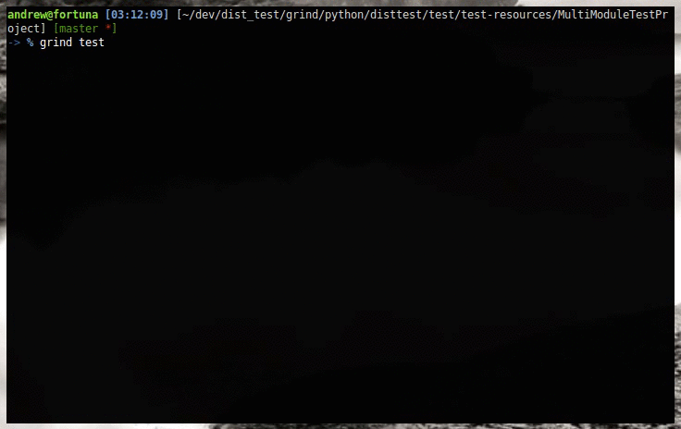

Slide 33
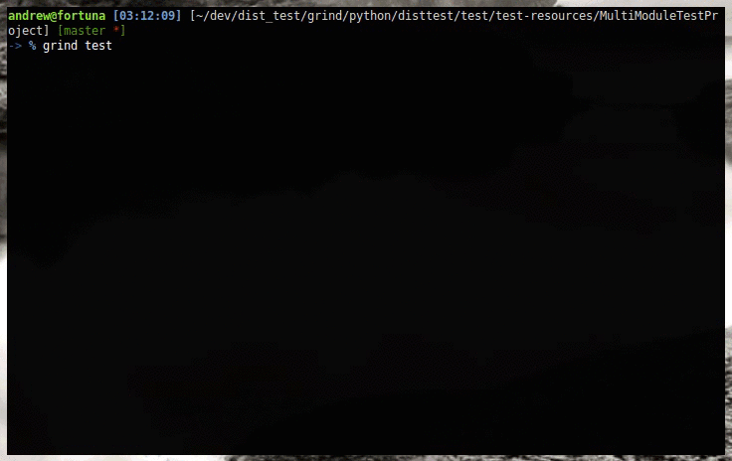

Slide 34
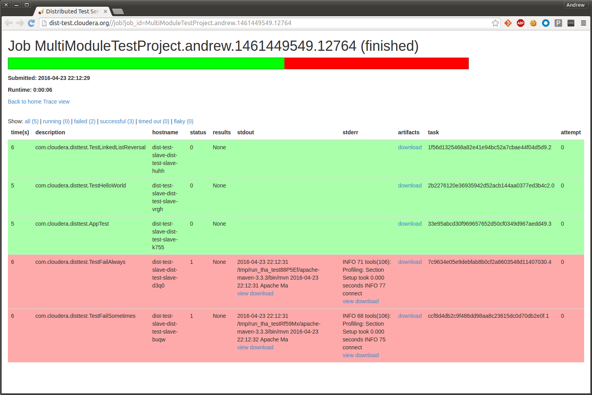

Slide 35
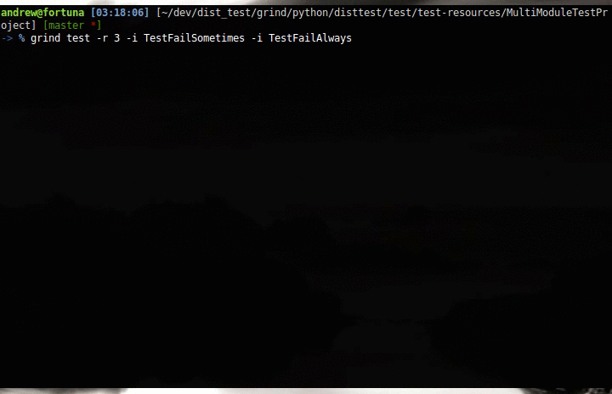

Slide 36
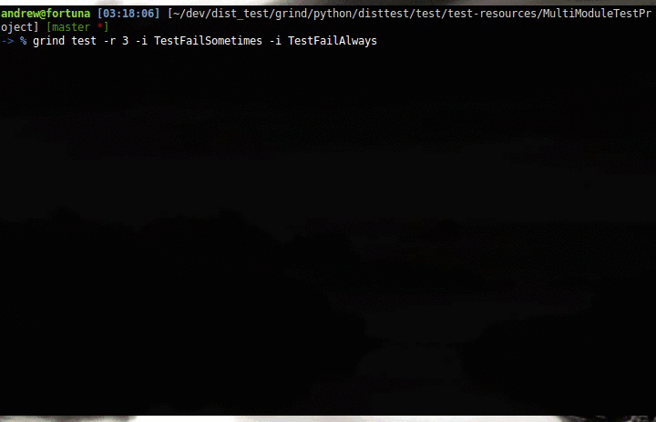

Slide 37
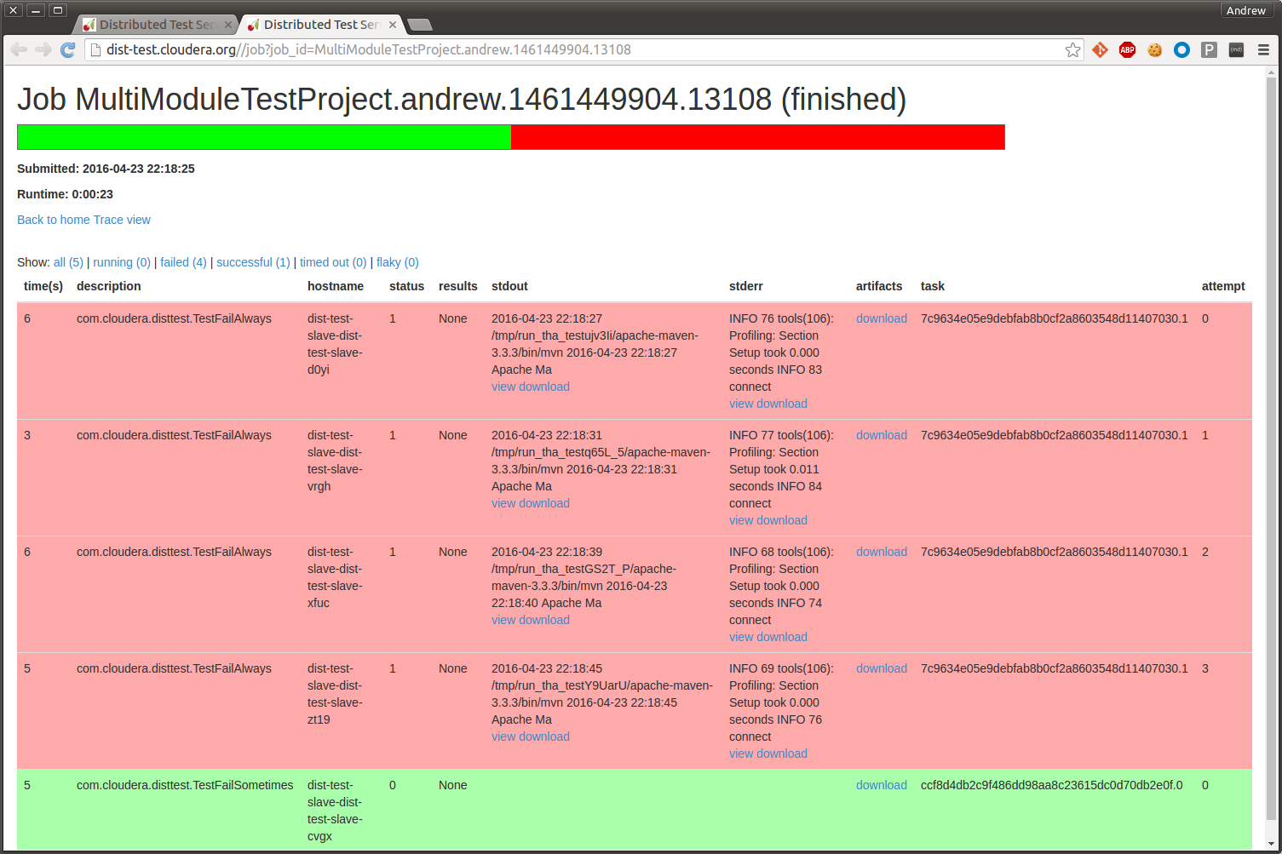

Slide 38
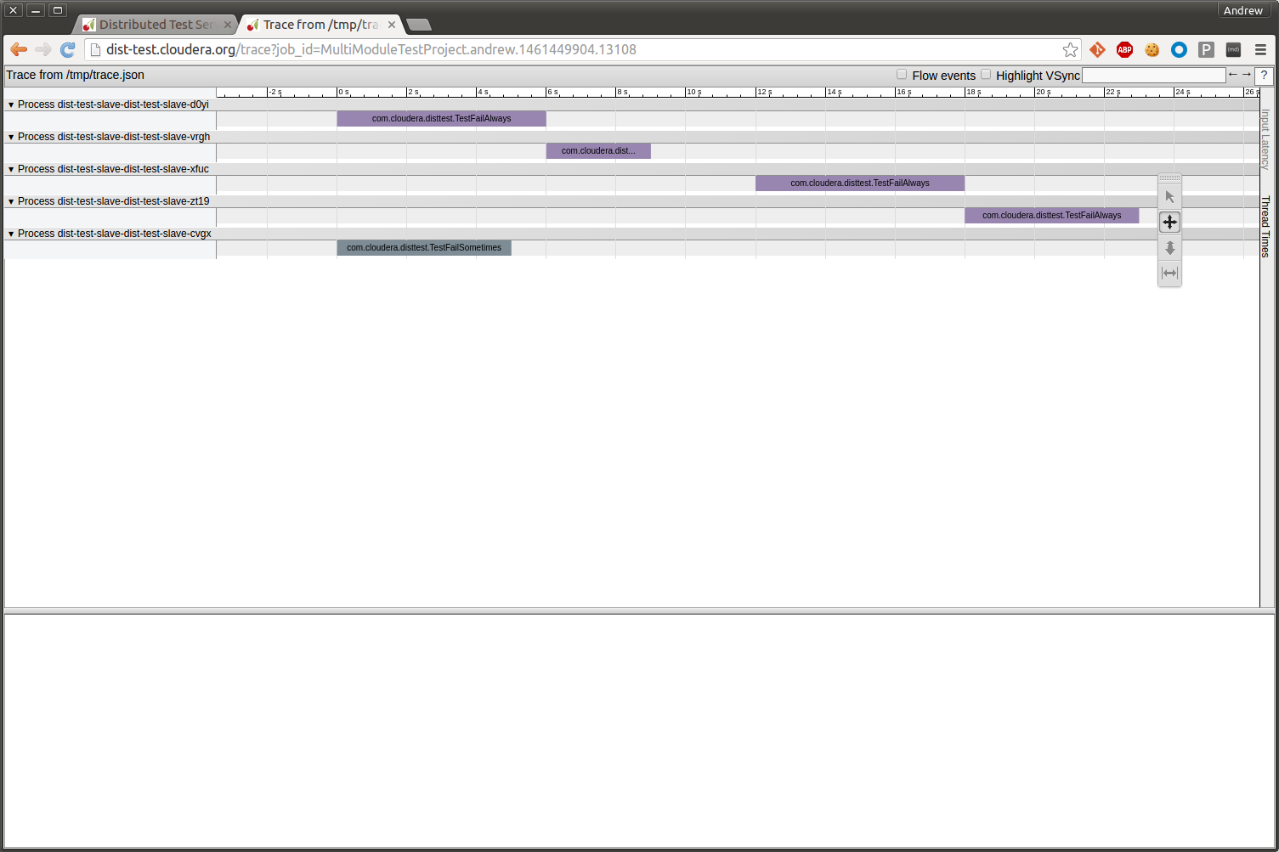

Slide 39
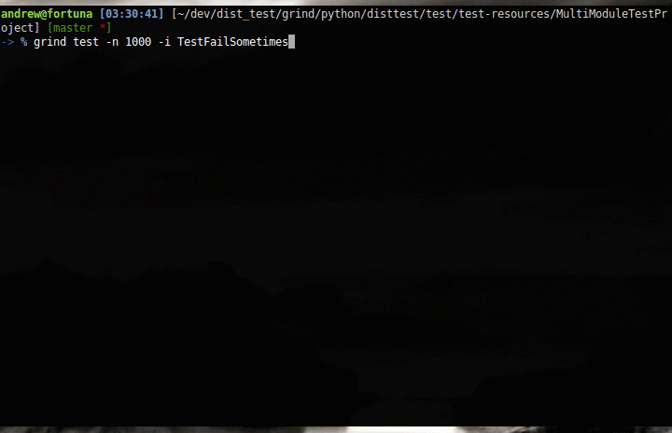

Slide 40
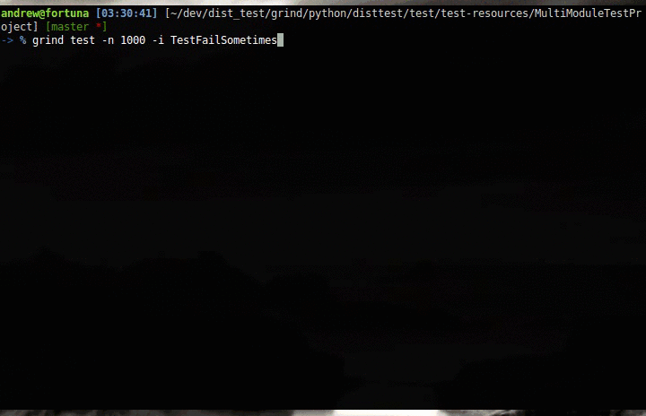

Slide 41
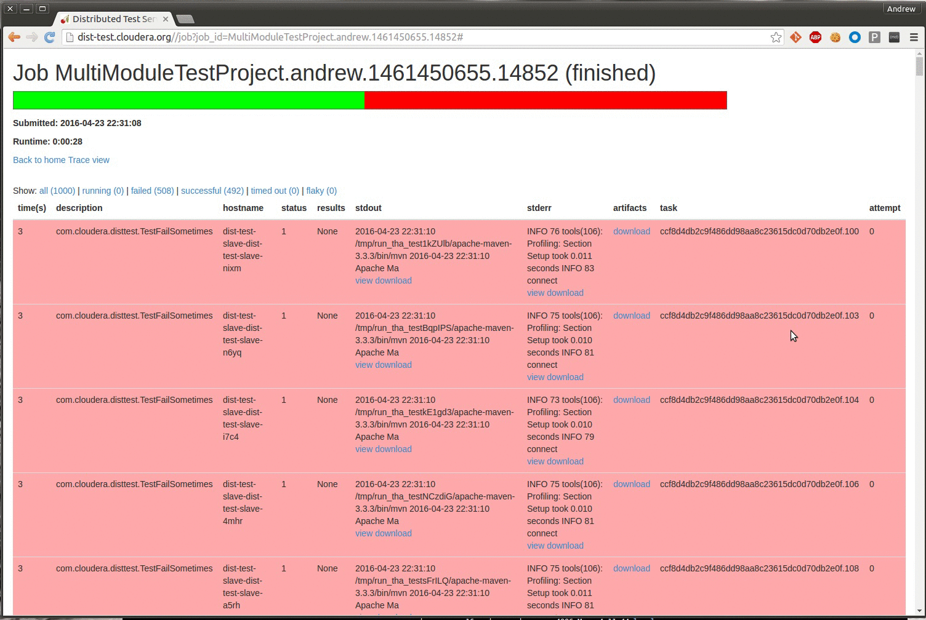

Slide 43
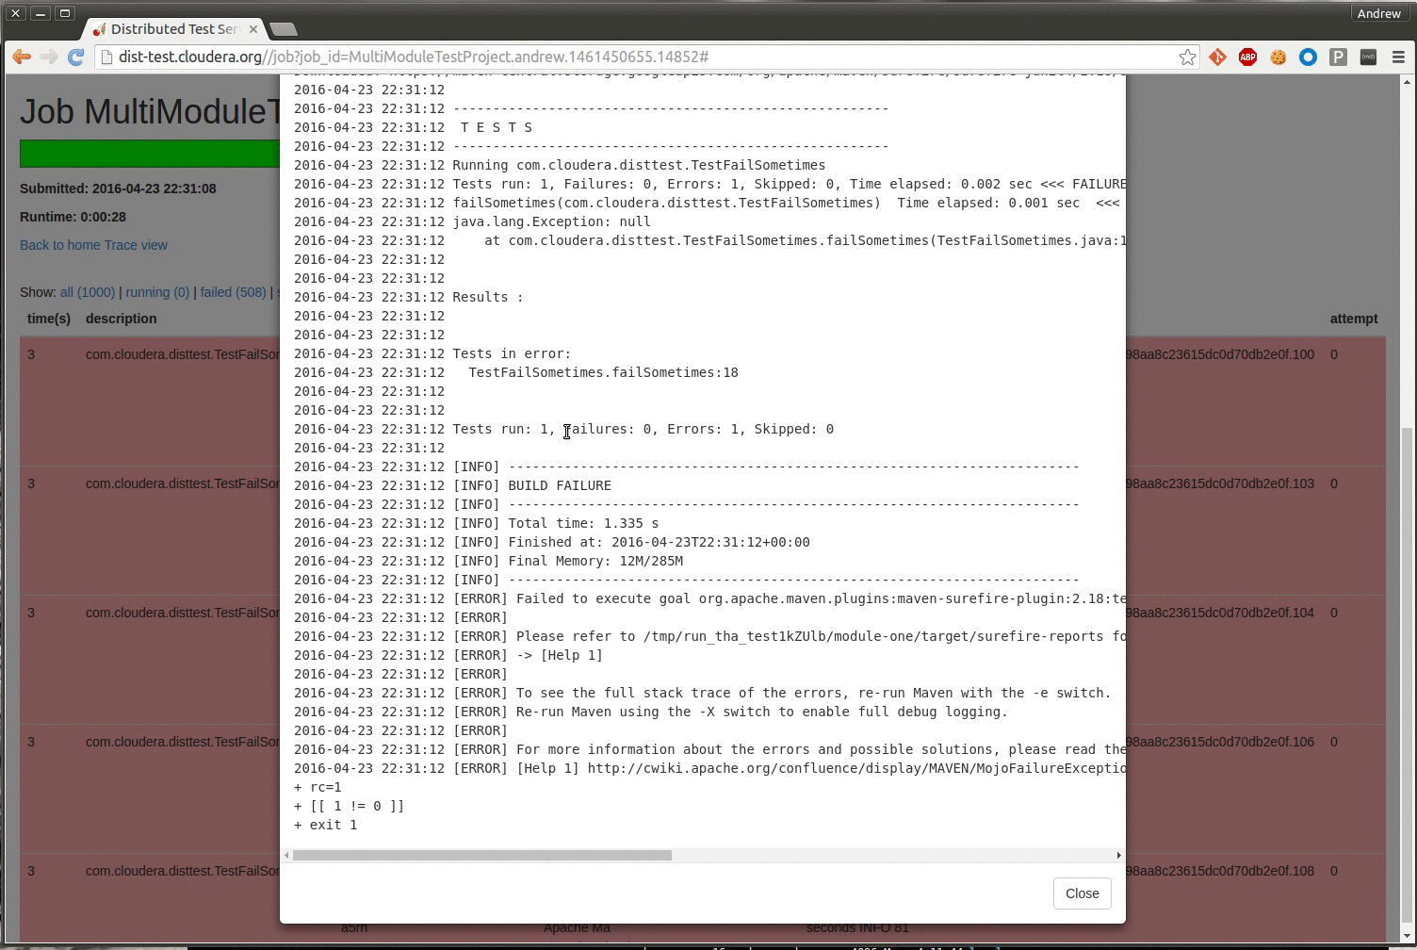

Slide 44
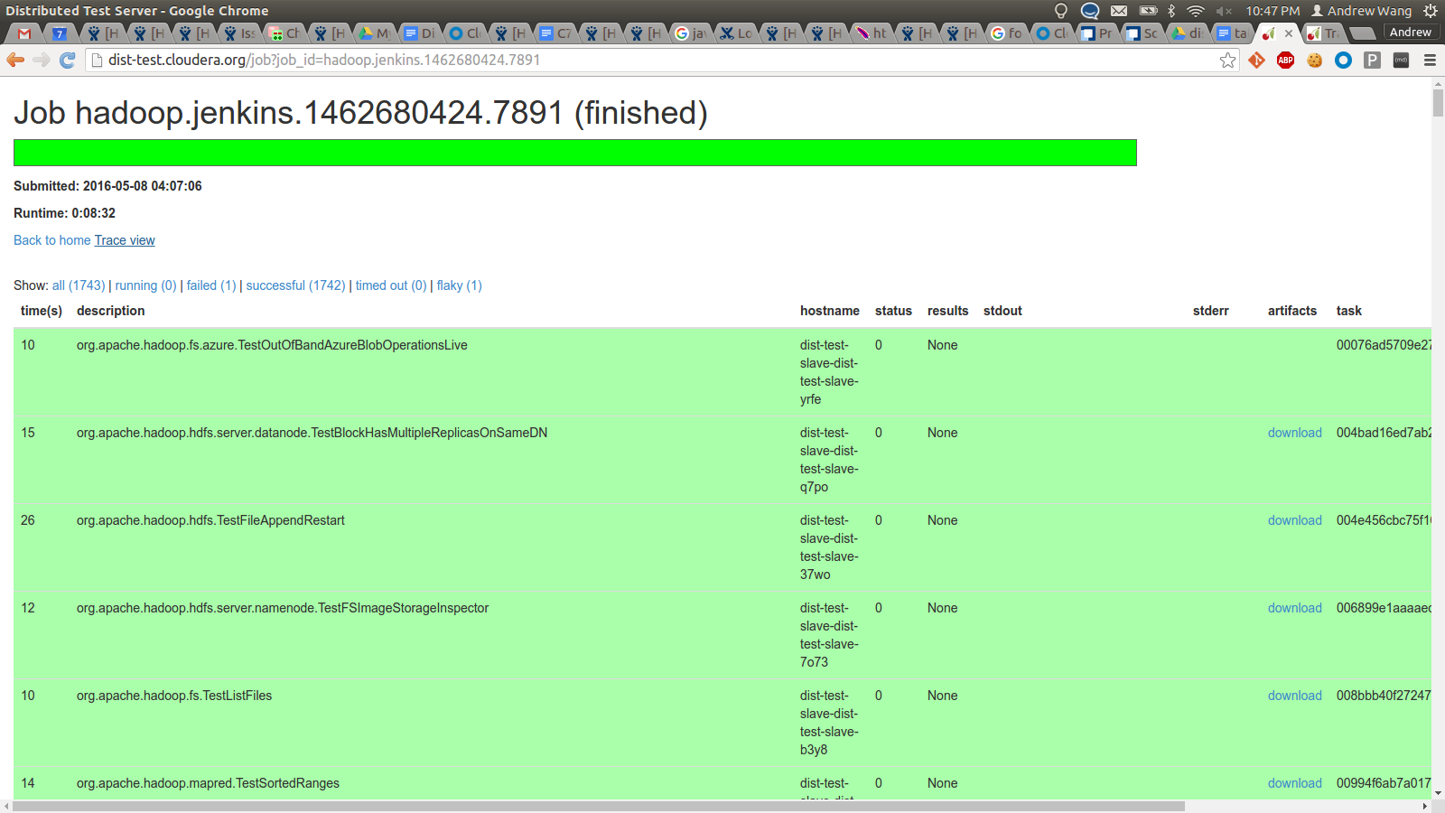

Slide 45
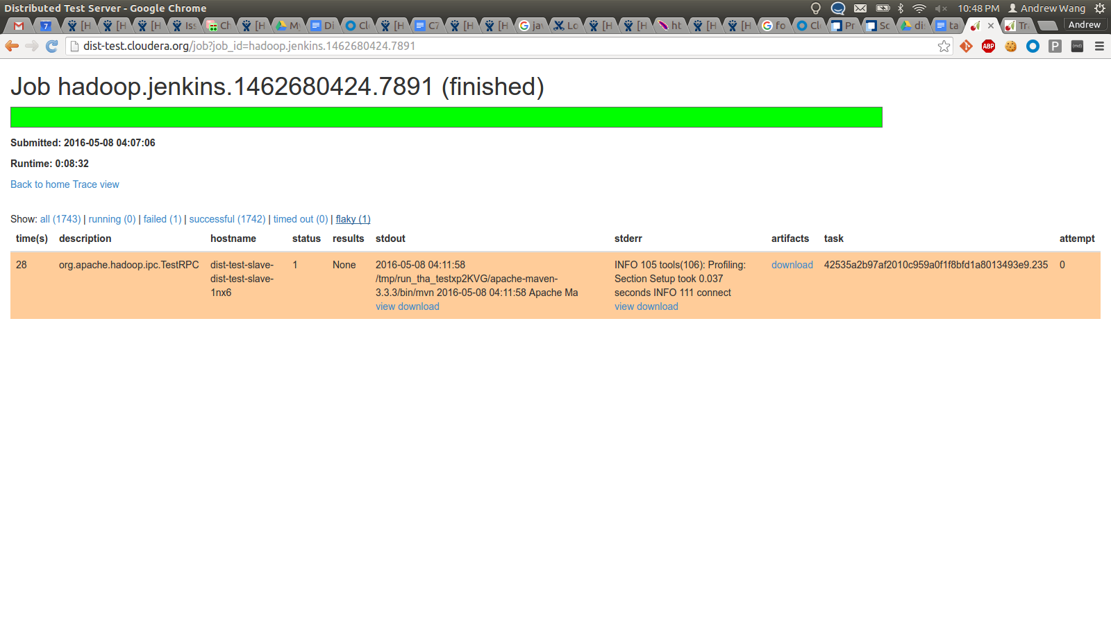

Slide 46
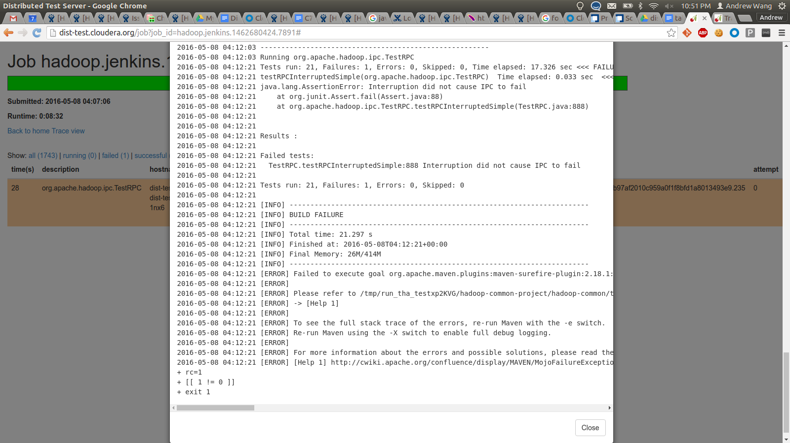

Slide 47
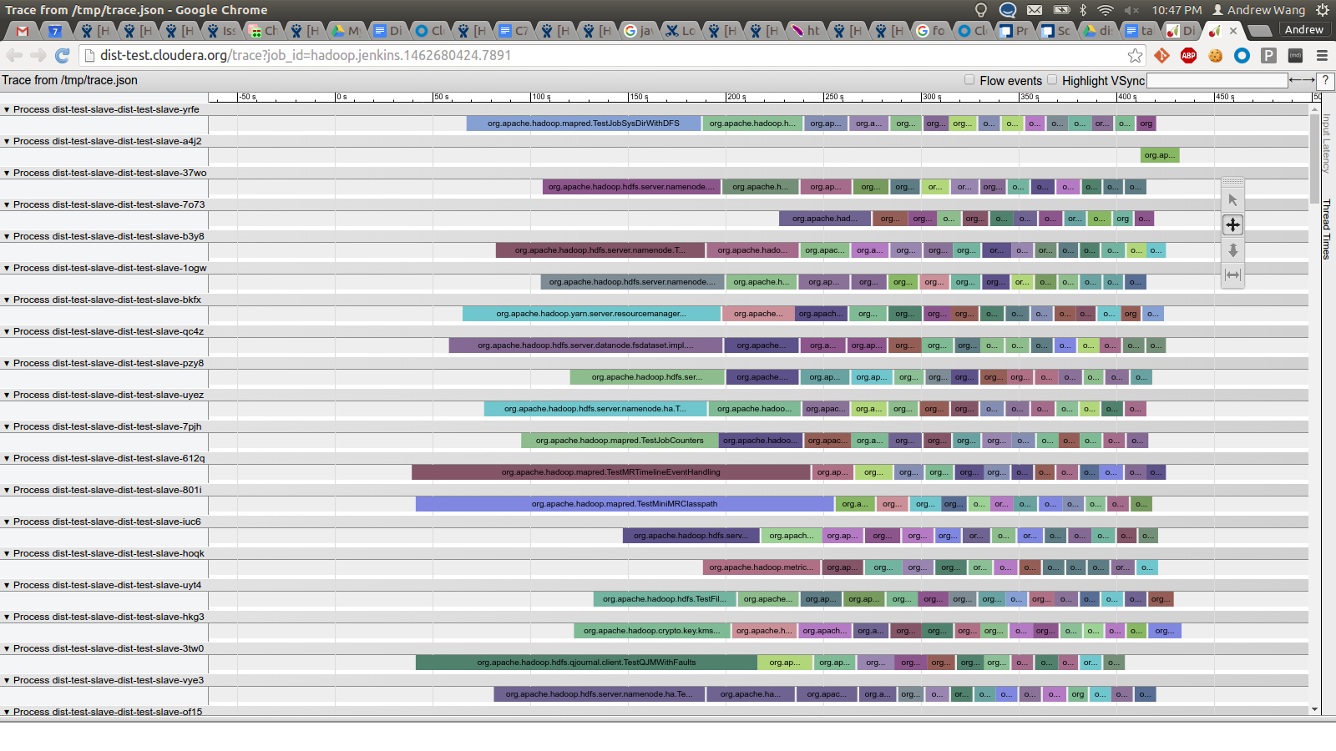

Slide 48
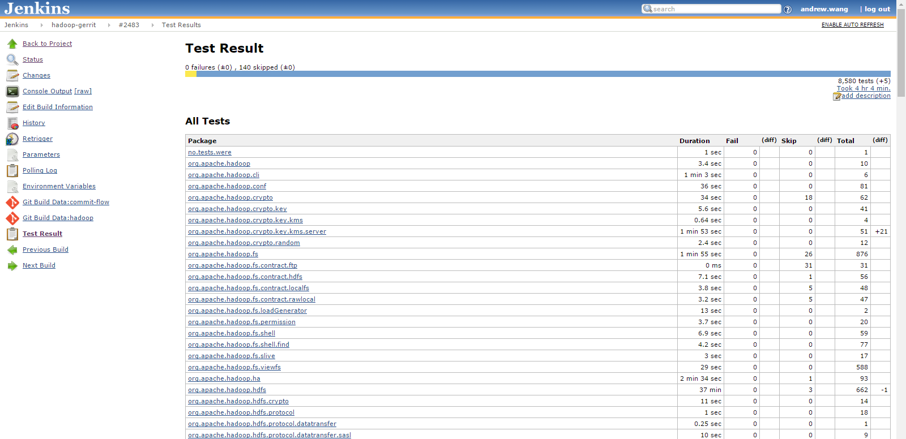

Slide 49
New developer workflows
Easily invoke distributed testing via CLI
Easily view test output from the CLI or GUI
Fast enough that you can run it during normal development
Easy to run a flaky test 1000 times to reproduce failures
No concerns about adding long-running end-to-end and fuzz testing
Raise the bar for precommit
  Run new+modified tests 1000 times to prevent introducing new flakies

Slide 50
Future work
Speed improvements
Improved installation steps for the backend
  Currently requires checking out specific git hashes of Isolate
Additional front-end support (Ant, Gradle, etc)
Using a real job scheduler for multi-tenancy (YARN?)
  Per-project job queues
  Prioritize user-submitted jobs over nightly test runs
Broader adoption

Slide 51
Conclusion
Distributed testing is very effective: 8.5 hours to <10 mins.
Distributed testing opens up new developer workflows
Already being used by Hadoop, Kudu, Hive, HBase teams at Cloudera
Open-source! ASLv2: https://github.com/cloudera/dist_test
A fast, thorough test suite improves software quality and developer productivity!
Notes:
In conclusion, I’ve presented a new open-source distributed testing framework already in use by multiple teams at Cloudera, which can be generalized to any software project. This distributed testing framework has reinvigorated the unit test suite as a useful developer tool, and has opened up brand new developer workflows: making it much easier to debug flaky tests, as well as having the freedom to add long-running system and fuzz tests without having to worry about increasing the runtime of the test suite.
Finally, I’d like to repeat something I said at the beginning of the presentation. Unit tests are the first line of defense against introducing new software defects. Thus, a fast, easy-to-use test suite leads to both happier software and happier developers.

Slide 52
Resources
http://blog.cloudera.com/blog/2016/05/quality-assurance-at-cloudera-distributed-unit-testing/
https://github.com/cloudera/dist_test

Slide 53
Thank you
andrew.wang@cloudera.com
@umbrant

