Slide 1
Transparent Encryption in HDFS
Charles Lamb clamb@cloudera.com
Andrew Wang andrew.wang@cloudera.com

Slide 2
Why do we need encryption?
Notes:
First, a basic question: why do we need encryption? Well, there have been a number of high-profile leaks of confidential information in recent years. For example, last year, Sony suffered “The Interview” hack, where hackers leaked unreleased movies and scripts, and the year before that, Target was hacked, exposing the credit card information of 77 million customers. Since the postmortems for these hacks are rarely released, it’s difficult to pinpoint if they would have been prevented by encryption, but during my Google search, I did find one example.

Slide 3
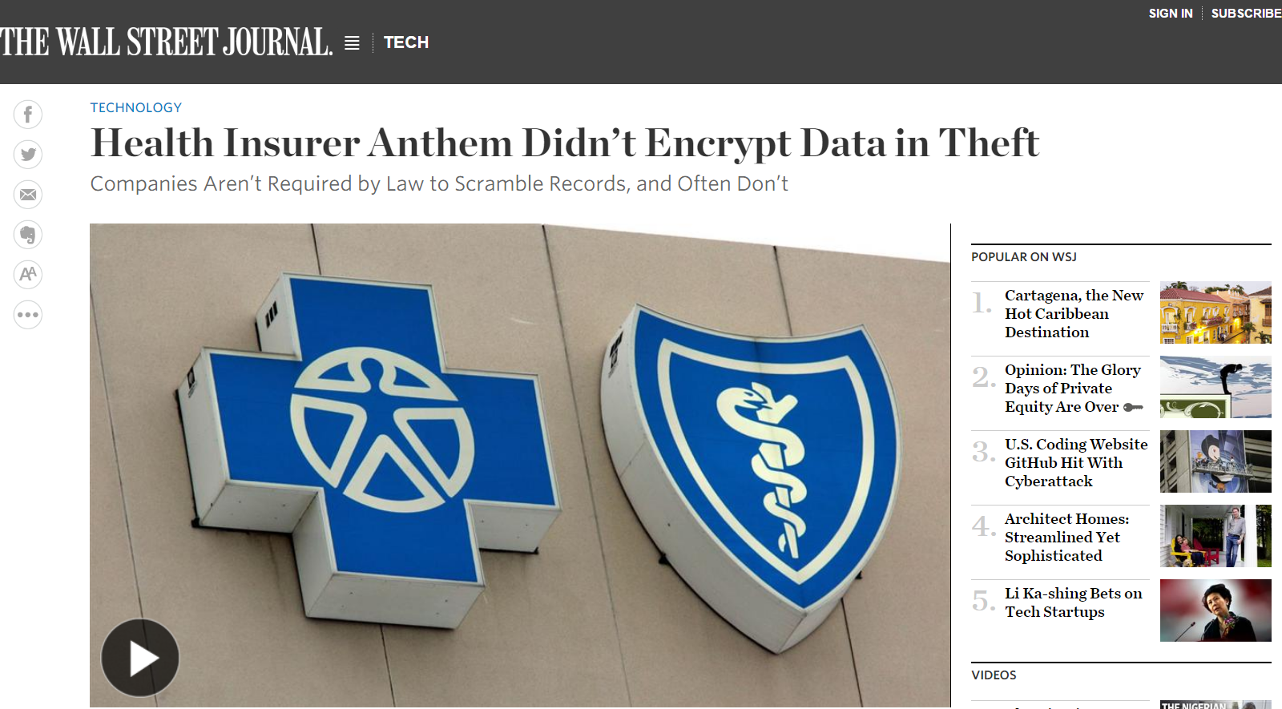
Notes:
Anthem Blue Cross Blue Shield, a health insurance provider, was hacked just a few months ago. Attackers gained access to the personal information of approximately 80 million people, including credit card and social security numbers. As you can see, the Wall Street Journal kindly put the core issue right in the headline: “Anthem didn’t encrypt data in theft.” Anthem is now offering free credit monitoring to its customers, but the potential economic impact of the resulting credit card fraud is enormous.

Slide 4
Importance of Encryption
Information leaks affect 10s to 100s of millions of people
Personally identifiable information (PII)
Credit cards, SSNs, account logins
Encryption would have prevented some of these leaks
Encryption is a regulatory requirement for many business sectors
Finance (PCI DSS)
Government (Data Protection Directive)
Healthcare (DPD, HIPAA)
Notes:
Andrew owner

Slide 5
Access to Sensitive Information
Only as secure as the weakest link
Need to carefully control access to:
Encryption keys
Encrypted ciphertext
Keys and ciphertext together (and thus plaintext!)
Many potential attack vectors

Slide 6
Physical Access
Notes:
Physical access is the most straightforward threat. This affects data stored at-rest on a hard drive. An attacker might walk into a datacenter and then walk out with datanode hard drives containing sensitive information. If this seems farfetched, another method is to buy used hard drives on Ebay and try to extract deleted data.

Slide 7
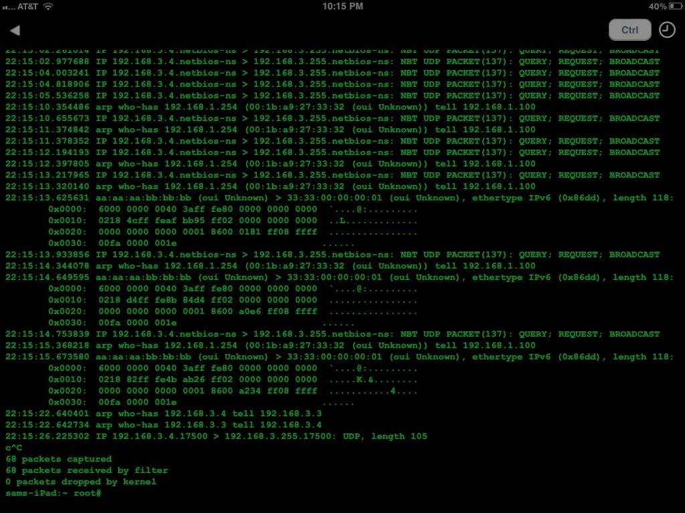
Network Sniffing
Notes:
Network sniffing is another common attack vector. If a hacker penetrates through the firewall, they can use tcpdump or snort to record network traffic. If your sensitive data (meaning encryption keys or plaintext) is not encrypted while in-transit over the wire, it’s vulnerable to network sniffing.

Slide 8
Rogue User/Admin
Notes:
The last attack vector is a rogue user or admin. This is one of the hardest to deal with. If a hacker compromises a user account, they also gain access to all the information that user would normally have access to. If this user account is also a system administrator, then this threat could be even more serious because of the broad access typically granted to sysadmins. The goal here is to limit the access of any single user, including sysadmins, such that no single user has access to both all the encryption keys stored in the key server, as well as all the encrypted ciphertext stored in HDFS.

Slide 9
Attack Vectors
Physical access
Data at-rest on hard drives
Network sniffing
Data in-transit on the network
Rogue user or admin
Insider access to encrypted data, encryption keys
Particularly difficult for admins

Slide 10
Why Encrypt in HDFS?
Application
Database
Simplicity
HDFS
Flexibility
Local Disk
Notes:
So, we’re now convinced that these attacks are an issue, and encryption is a concrete solution. Now, the question becomes, why encrypt within HDFS? Looking at this diagram, it’s possible to encrypt at any of these four layers: application code, meaning the code written by end users of Hadoop, the database, meaning something like Hbase, HDFS, the distributed filesystem, or all the way down at local disk.
Each of these has its advantages, but also it’s tradeoffs. Broadly speaking, as you move down the stack, operation and deployment becomes simpler. And as you move up the stack, you gain in terms of flexibility, or improved application-level semantics.
Taking it from the extremes, local disk refers to encrypting at the OS level. There are products such as Vormetric or Cloudera Navigator Encrypt which interface at the system call layer, and automatically encrypt and decrypt data bring written by userspace applications. It couldn’t be simpler in terms of operation and deployment, and existing applications can work on encrypted data no problem. However, you lose out heavily in terms of being able to express application semantics. If you’re running HDFS, a block is essentially encrypted three times as it’s replicated three times, which increases CPU overhead. Also, there’s no way to express a policy like “encrypt all replicas of an HDFS file with the same encryption key”, since each local disk works independently.
At the application level, you have maximum flexibility. You can express policies like, encrypt by file, encrypt by column, encrypt by user, which are impossible at lower layers. However, this requires more work on the part of the application developer, and this work is also specific to each application. It also doesn’t work with legacy or proprietary applications that cannot be easily modified.
ach of these comes with tradeoffs.

Slide 11
Why Encrypt in HDFS?
Application
HDFS is a sweet spot
Excellent performance
Safe from OS attacks
App transparency
Easy to deploy
Database
HDFS
Local Disk
Notes:
This is why we consider HDFS to be something of a sweet spot. We get excellent performance, and end-to-end client-side encryption means data is safe from OS-level attacks which affect data in-transit and data at-rest. Furthermore, HDFS encryption is transparent to existing Hadoop applications, and since encryption is built into HDFS, it’s pretty easy to use and deploy.
We essentially gain the benefits of local disk encryption, while bringing it to the world of distributed filesystems.

Slide 12
Architecture
KMS
KS
Key Management Server
Backing
Key Server
Client
NN
NameNode
DN
DataNode
Notes:
The KMS is a high-performance, scalable, highly available caching proxy for a backing enterprise key server. The KMS is intended to offer a unified key API for cluster services, while allowing users their choice of backing key server.

Slide 13
Architecture
KMS
KT
Key Management Server
Cloudera
Navigator
KeyTrustee
Client
NN
NameNode
DN
DataNode

Slide 14
Architecture
KMS
KT
Per-file key operations
Client
NN
Read/write encrypted data
DN

Slide 15
Architecture
KMS
KT
Keys
Client
NN
Separate administrative domains
Data
DN

Slide 16
Design
KMS and key server manage encryption keys
HDFS never touches encryption keys or plaintext
End-to-end client-side encryption
Data is protected both at-rest and in-transit
Granular per-file encryption keys and per-key ACLs
Rogue user can only leak their own data
Separate administrative domains for key management and HDFS
Rogue admins do not have access to both keys and data
API transparency for existing applications
High-performance
Notes:
In case you were distracted, this is the most important slide in the presentation.
Go very slowly and repeat yourself

Slide 17
Architectural Concepts
Encryption zone (EZ)
Key types: EZ keys, (E)DEKs
Key Management Server (KMS)
Key handling during writes and reads
Notes:
Charlie starts here

Slide 18
Encryption Zones (EZs)
Directory whose contents are encrypted on write and decrypted on read
Encryption is transparent to applications (simple!)
No code changes required
Invariant: files in an EZ are encrypted, files not in an EZ are not encrypted
Existing files are not encrypted in place
An EZ begins life as an empty directory
Renames in to and out of an EZ are prohibited
Encryption zones cannot be nested

Slide 19
Recommended EZ Setup
Single root encryption zone
Pros: conceptually simple, easy to configure
Cons: less secure, hard to migrate to multiple EZs
Separate per-user or per-org encryption zones
Pros: compartmentalizes security
Cons: more keys to manage

Slide 20
Encryption Zone Key (EZ key)
Unique key per encryption zone
EZ key metadata is stored in an xattr on the EZ root directory
EZ key material is stored in the Key Management Server
NameNode never touches the key
Notes:
Just define each acronym / key type

Slide 21
(Encrypted) Data Encryption Keys
Data Encryption Key (DEK)
Unique DEK per file
Used by client to encrypt and decrypt data in HDFS
Only handled by client and KMS, never HDFS
DataNodes never handle plaintext, only ciphertext
Encrypted Data Encryption Key (EDEK)
DEK encrypted with corresponding EZ key
Generated by KMS for NameNode
Stored in HDFS metadata as a file xattr
Notes:
Just define each acronym / key type

Slide 22
EZ Keys, DEKs, and EDEKs

Slide 23
EZ Keys, DEKs, and EDEKs

Slide 24
Key Management Server
Caching proxy for an enterprise key server
Presents a unified key API to cluster services
Scalable, fault-tolerant, high-performance
Typically backed by Cloudera Navigator KeyTrustee
Handles key operations with fine-grained ACLs
Create and retrieve EZ keys
Generate and decrypt EDEKs
Separate secure process
Separate key administrator
Notes:
Just define each acronym / key type

Slide 25
Writing an Encrypted File
KMS
Fetch EDEK for /ez/
Client
NN
myFile
create /ez/myFile
DN

Slide 26
Writing an Encrypted File
KMS
Decrypt EDEK
Fetch EDEK for /ez/
Client
NN
myFile
create /ez/myFile
Write encrypted data
DN
File data

Slide 27
Reading an Encrypted File
KMS
Decrypt EDEK
Client
NN
myFile
open /ez/myFile
Read encrypted data
Decrypt with DEK
DN
File data

Slide 28
Key Handling
Writing a file
Client asks NameNode to create a file in an EZ
NameNode gets a new EDEK from KMS
NameNode stores EDEK in file’s xattr and returns EDEK to client
Client asks KMS to decrypt EDEK
KMS decrypts EDEK and returns DEK to client
Client uses DEK to encrypt file data
Notes:
Just define each acronym / key type

Slide 29
Key Handling
Reading a file
Client asks NameNode for file’s EDEK
Client asks KMS to decrypt EDEK
KMS decrypts EDEK and returns DEK to client
Client uses DEK to decrypt data
Notes:
Just define each acronym / key type

Slide 30
Granular Access Controls
Granular HDFS-level access controls
Controls access to encrypted ciphertext
HDFS ACLs and Unix-like permissions
Granular KMS-level access controls
Per-EZ key ACLs
Per-operation ACLs (generate and decrypt EDEKs)
Whitelist and blacklist
See our docs
Notes:
The KMS ACLs are very sophisticated. I recommend going to the Cloudera documentation to see our recommended configuration for KMS ACLs….

Slide 31
Attack Vectors
Compromised EZ key
Also requires EDEK and ciphertext
Only leaks a single zone
Compromised EDEK
Also requires EZ key and ciphertext
Only leaks a single file
Compromised ciphertext
Also requires corresponding EZ key and EDEK
Only leaks a single file
Notes:
So let’s walk through what happens if an attacker gains access to sensitive keys or data.
If the KMS ACLs are not set up correctly, an attacker might gain access to an EZ key. However, to gain access to plaintext, the attacker also needs EDEKs and ciphertext of files stored in that EZ key’s encryption zone. So, as long as the HDFS permissions are set up correctly, the attacker cannot gain access. Even if they do gain access HDFS, the worst case is only that single zone is compromised…
Lather rinse

Slide 32
Quickstart: Create a key and an EZ
$ # as the key administrator user
$ hadoop key create mykey
$ # as the HDFS administrator user
$ hadoop fs –mkdir /users/cwl/my-ez
$ hadoop fs –chown cwl /users/cwl/my-ez
$ hadoop fs –chmod 700 /users/cwl/my-ez
$ hadoop crypto –createZone –keyName mykey \
–path /users/cwl/my-ez

Slide 33
Quickstart: put and get a file into the EZ
$ # as the encryption user
$ echo “hello world” > hello-world.txt
$ hadoop fs –put hello-world.txt /users/cwl/my-ez/
$ hadoop fs –cat /users/cwl/my-ez/hello-world.txt
hello world
$
Notes:
Be sure to mention transparency

Slide 34
Quickstart: verify the file is encrypted
$ # as the HDFS admin
$ hadoop fs –cat \
/.reserved/raw/users/cwl/my-ez/hello-world.txt
��嶗]ܙN^���+���
$

Slide 35
Encryption Ciphers
Currently, only AES-CTR is implemented
128 or 256 bit keys
Cipher is designed to be pluggable
Other ciphers are future work
AES-GCM would provide authenticated encryption
Great place for contributions!

Slide 36
AES-NI Hardware Acceleration
Joint work with Intel engineers
Two implementations of AES-CTR
JCE software implementation
OpenSSL hardware-accelerated AES-NI implementation
AES-NI is available in Westmere (2010) and newer Intel CPUs
AES-NI further optimized in Haswell (2013)

Slide 37
Microbenchmark: Encrypt/Decrypt 1GB Byte Array
How much faster is AES-NI accelerated AES-CTR?
Encrypt and decrypt a 1GB byte array
Single-threaded
Run locally on a single Haswell machine
Excludes HDFS overheads (checksumming, network, copies)

Slide 38
Microbenchmark: Encrypt/Decrypt 1GB Byte Array
16x speedup
Notes:
Microbenchmark
CPU: Intel(R) Xeon(R) CPU E3-1285 v3 @ 3.60GHz (Haswell)
Algorithm: AES CTR mode
Java Version: jdk 1.6.0_37
L1d cache: 32K
L1i cache: 32K
L2 cache: 256K
L3 cache: 8192K
1. Methodology 1 - 1 GB data as single byte array performance
This method created a 1GB byte array for input data. And a separate 1GB byte array for output data.
For each iteration, it will encrypt or decrypt the 1GB byte array. For each read and write call, we use 1M buffer.
In this method, 1GB input data is not possible to be cached in any level of the cached. But even it is 1GB byte data, it still shows good CPU cache behavior. Because when reading through the input data, the data following in the array can be pre-fetched to CPU cache and the next reading operation will be faster. Usually, this is also achievable for real application.

Slide 39
Macrobenchmark: TestDFSIO
What is the overhead of using encryption?
TestDFSIO
IO-heavy benchmark
Reading and writing 300GB files
Encrypted vs. unencrypted
Cluster setup
3 datanodes, so all reads are local
64GB memory, so datasize larger than memory
OpenSSL enabled, with Haswell AES-NI optimizations
Notes:
tested using TestDFSIO benchmark
(300GB for each file, total 3 files)
-------------------------------------------
Cluster env:
4nodes, 1 for NN, 3 for DN
CPU: 2 * Xeon CPU E5-2690v2 3.00GHz
Mem: 64GB
2HDD for each DN
Network: need to confirm.

Slide 40
Macrobenchmark: TestDFSIO
7.5% performance impact on read
Negligible impact on write
Notes:
tested using TestDFSIO benchmark
(300GB for each file, total 3 files)
-------------------------------------------
Cluster env:
4nodes, 1 for NN, 3 for DN
CPU: 2 * Xeon CPU E5-2690v2 3.00GHz
Mem: 64GB
2HDD for each DN
Network: need to confirm.

Slide 41
Performance Takeaways
OpenSSL and AES-NI acceleration is highly recommended
16x microbenchmark speedup
Minor performance impact on HDFS reads and writes
7.5% for reads, ~0% for writes
Most realistic workloads will see little to no impact
TestDFSIO is extremely IO bound
Terasort comparisons had no difference in runtime

Slide 42
Conclusion
End-to-end, client-side encryption
Data protected at-rest and in-transit
Key Management Server and Cloudera Navigator KeyTrustee
Secure key management, storage, access
Separate administrative domains for key management and HDFS
API transparent for existing applications
Performance transparent
Marginal overhead with AES-NI hardware acceleration

Slide 43
Acknowledgements
Cloudera
Alejandro Abdelnur
Aaron T. Myers
Arun Suresh
Colin McCabe
Intel
Yi Liu
Haifeng Chen
Notes:
Redo this once we are done with the rest of presentation
Should be basically the outline

Slide 44
Questions
Notes:
Add our emails here

Slide 45
Key Rotation
Encryption zone keys can be rolled
Newly generated EDEKs use the new key version
Currently no support for reencrypting existing EDEKs
Still encrypted with the old key version
Doable, but requires a lot of KMS RPCs from NN
Rolling DEKs is also unsupported
Requires reencrypting the data, expensive
One method is to distcp and then delete the old copy
Notes:
Andrew owner

Slide 46
DistCp
Encryption Zone to Encryption Zone
use –update –skipcrccheck
Admins use special /.reserved/raw path prefix
/.reserved/raw is only available to root and provides the encrypted contents

Slide 47
KMS Per-User ACL Configuration
White lists (check for inclusion) and black lists (check for exclusion)
etc/hadoop/kms-acls.xml
hadoop.kms.acl.CREATE
hadoop.kms.blacklist.CREATE
… DELETE, ROLLOVER, GET, GET_KEYS, GET_METADATA, GENERATE_EEK, DECRYPT_EEK

Slide 48
KMS Per-Key ACL Configuration
etc/hadoop/kms-acls.xml
hadoop.kms.acl.<keyname>.<operation>
MANAGEMENT – createKey, deleteKey, rolloverNewVersion
GENERATE_EEK – generateEncryptedKey, warmUpEncryptedKeys
DECRYPT_EEK – decryptEncryptedKey
READ – getKeyVersion, getKeyVersions, getMetadata, getKeysMetadata, getCurrentKey
ALL – all of the above

Slide 49
Exceptions
Hive: may not be able to do a query that combines data from more than one encryption zone

Slide 50
Sample Icons

Slide 51
Key Management Server (KMS)
KMS sits between client and key server
E.g. Cloudera Navigator Key Trustee
Provides a unified API and scalability
REST API
Does not actually store keys (backend does that), but does cache them
ACLs on per-key basis

Slide 52
High-profile leaks
Many personal information leaks over the years
Feb 2015, PII of 80 million Anthem customers
Nov 2014, Sony Pictures Entertainment hack
Mar 2014, PII of 40 million Target customers
Apr 2011, 77 million PlayStation Network accounts
Jan 2009, 100 million HPS credit cards
Jan 2007, 45 million TJX SSNs and other personal information
Notes:
Andrew owner

Slide 54
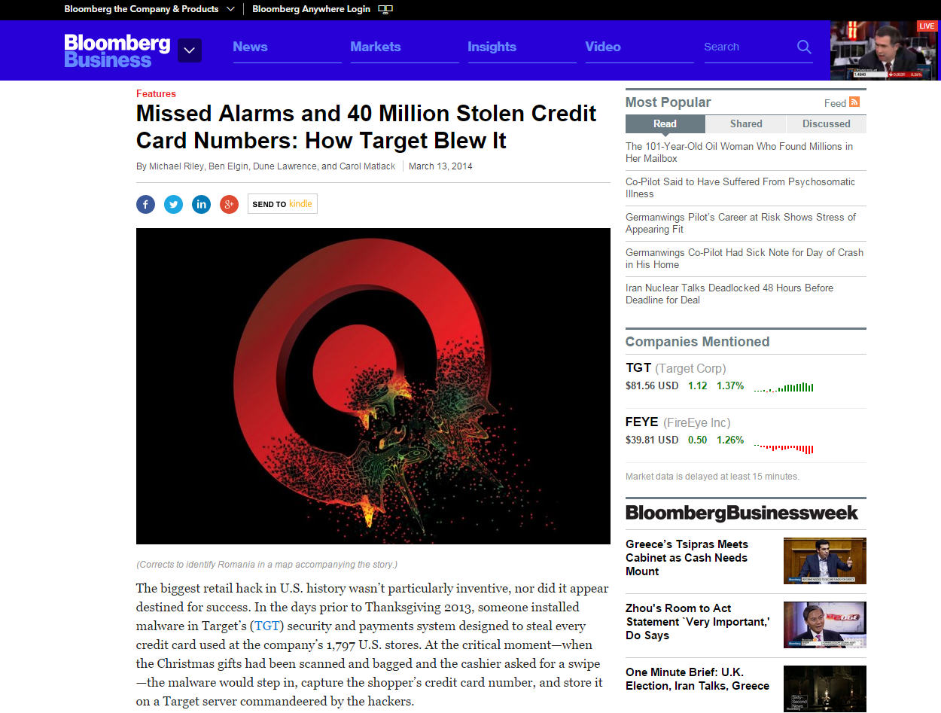
Notes:
In 2013, Target suffered one of the biggest security breaches in history. Hackers tapped into the Target’s credit card processing system to capture credit card information of holiday shoppers. This exposed at least 40 million people to possible credit card fraud, and Target ended up offering free credit monitoring to all of its customers.

Slide 55
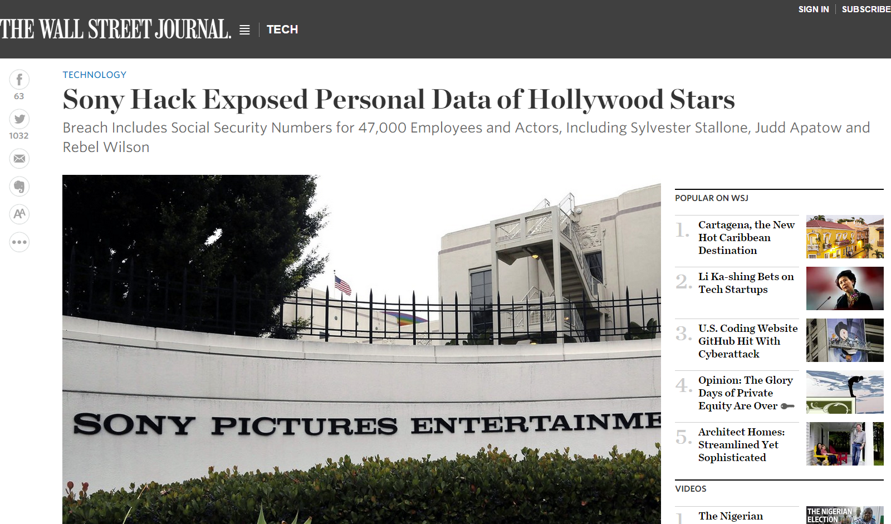
Notes:
In 2014, Sony was in the news for what was colloquially called “The Interview hack”, where hackers leaked footage and scripts of unreleased movies, as well as internal documents containing passwords, salaries, and personal information of actors and employees. Journalists had a field day poring through the released documents, and Sony was forced to subsequently cancel the theatrical release of The Interview.

